Slide 1
Data Analysis
SwissFEL 2019 Prep

Slide 2
Prerequisites
RA cluster account
GitHub account
Download Anaconda onto your personal computer

Slide 3
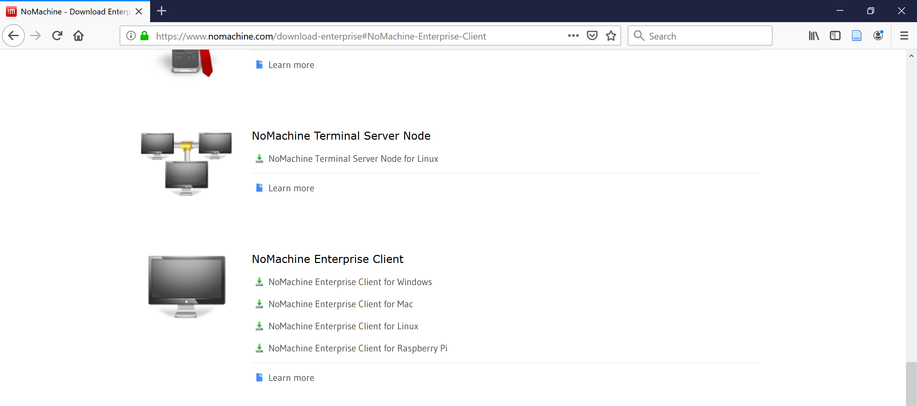
Install NoMachine

Slide 4
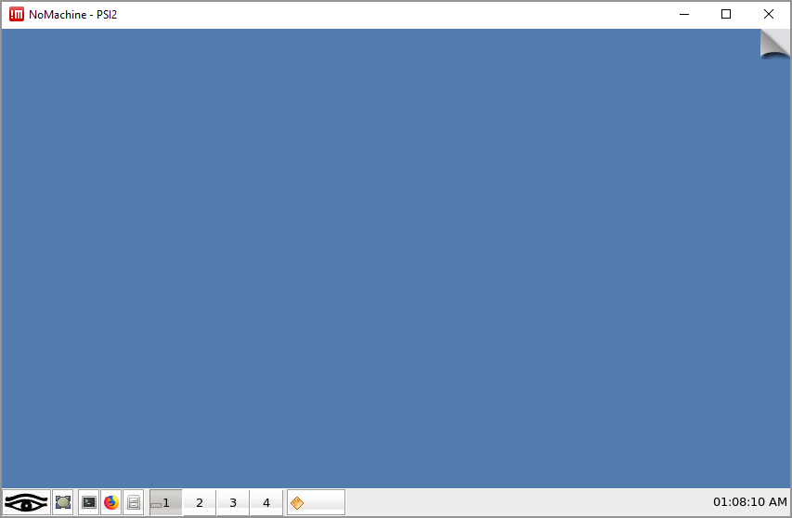
Set up NoMachine
https://www.psi.ch/en/photon-science-data-services/remote-interactive-access

Slide 5
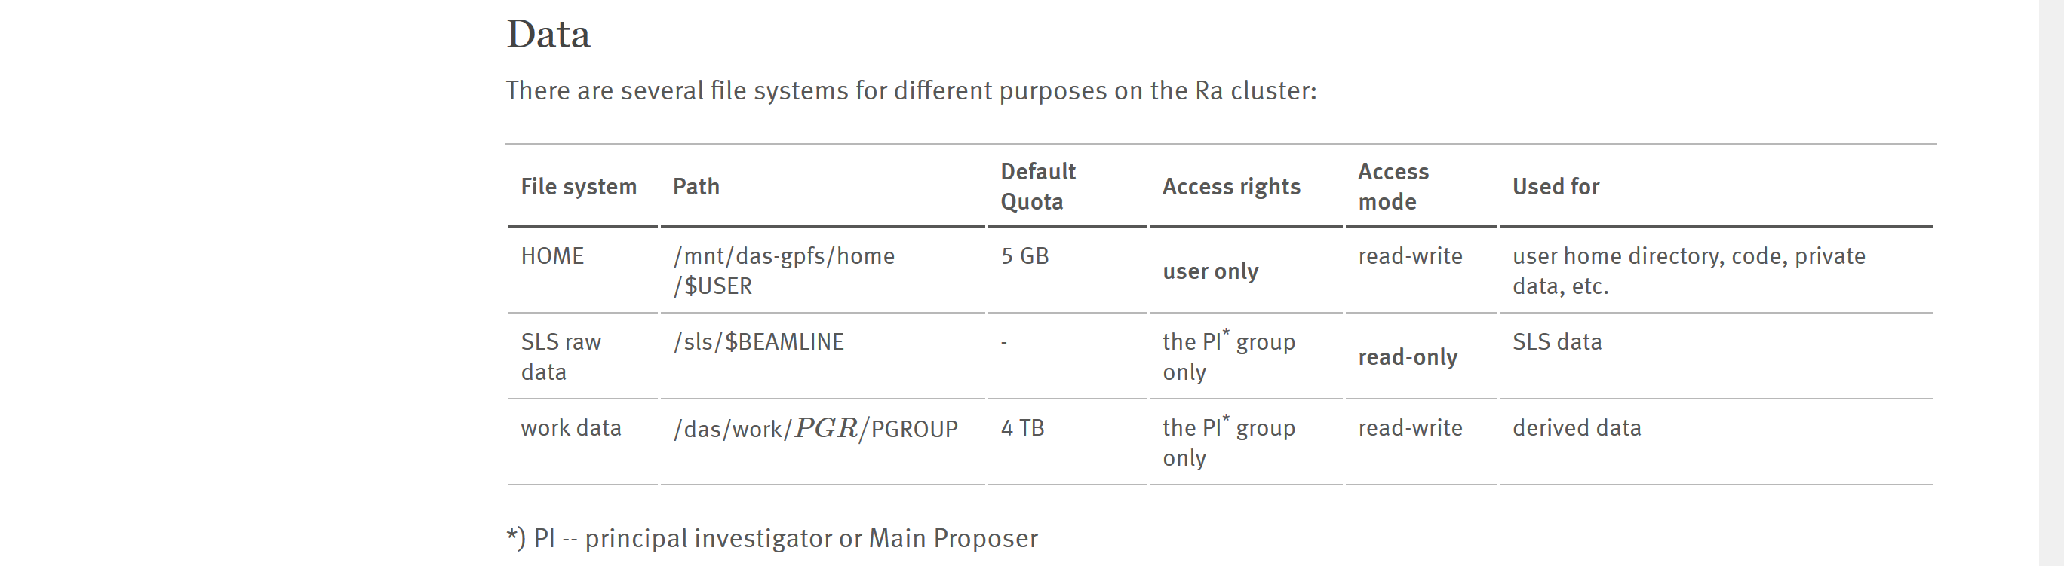
Where things are

Slide 6
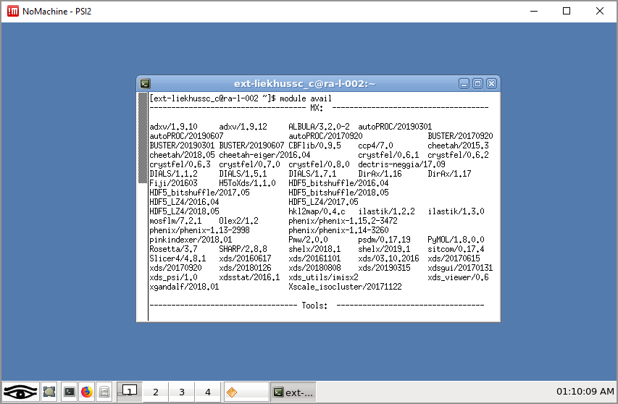
Setting up python

Slide 7
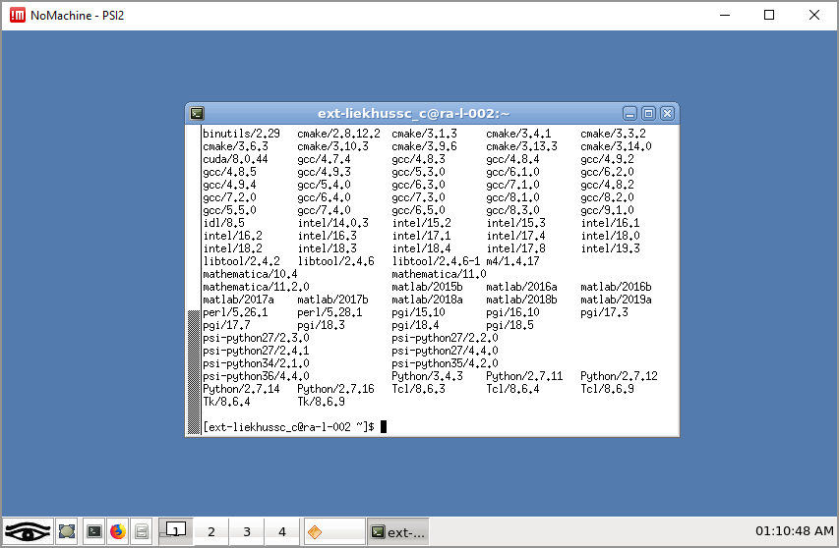
Setting up python

Slide 8
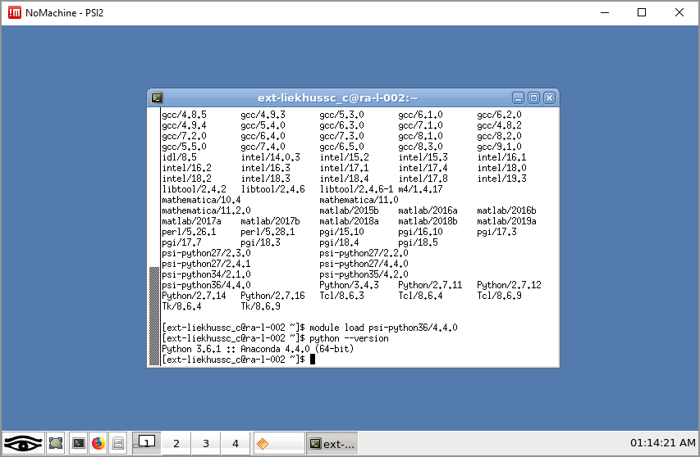
Setting up python

Slide 9
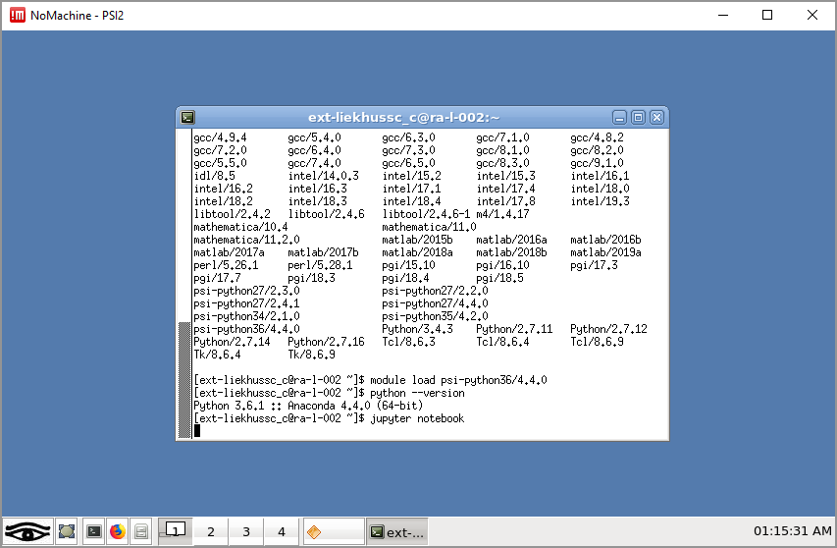
Starting a Jupyter Notebook

Slide 10
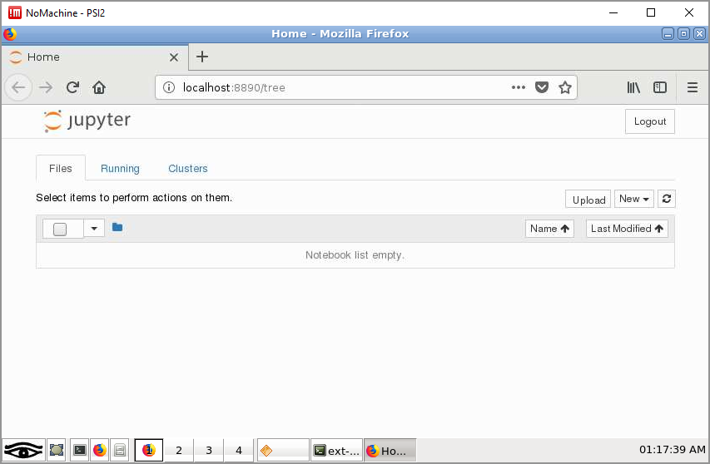
Starting Jupyter Notebook

Slide 11
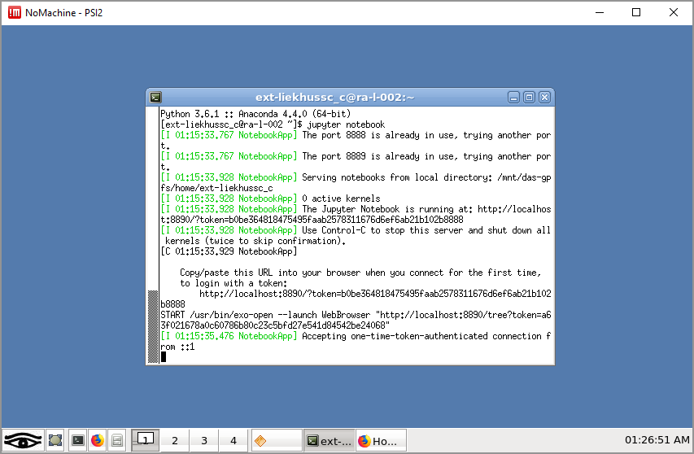
Closing Jupyter Notebook

Slide 12
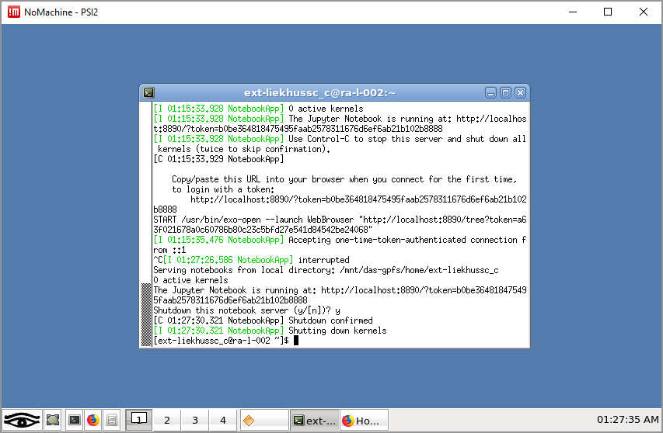
Closing Jupyter Notebook

Slide 13
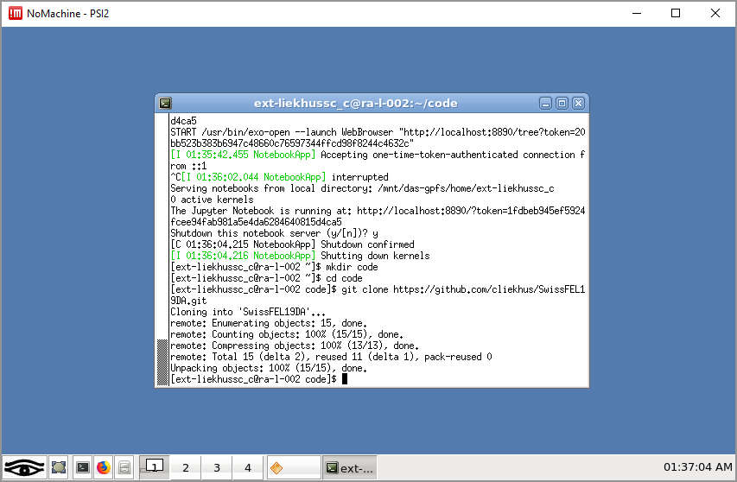
Connect to GITHUB

Slide 14
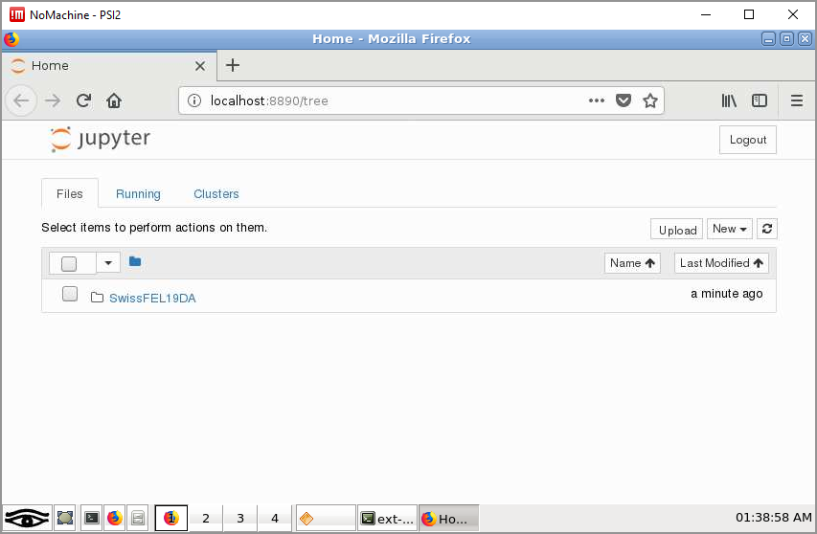
Using Jupyter Notebook

Slide 15
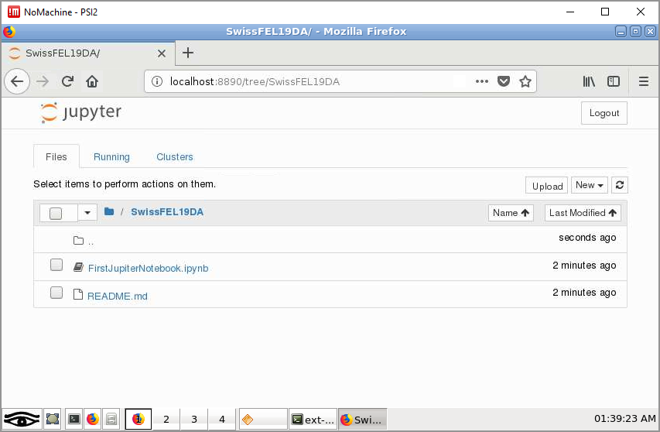
Using Jupyter Notebook

Slide 16
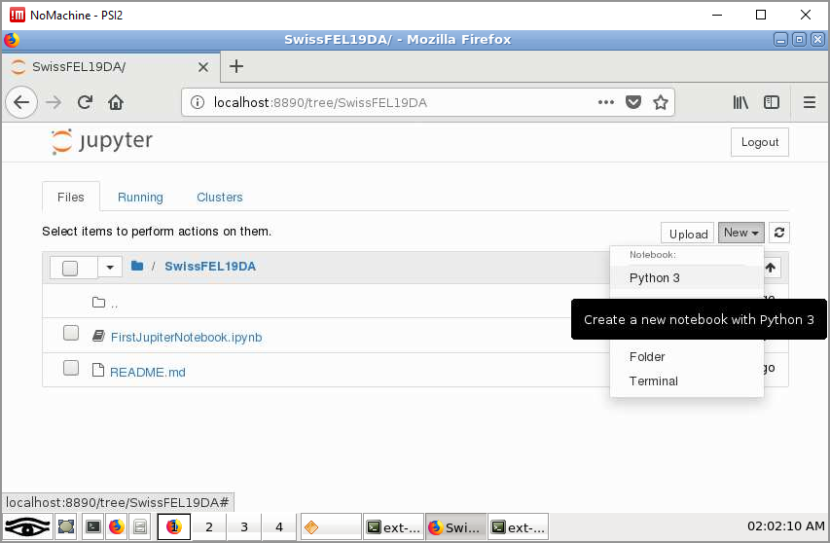
Using Jupyter Notebook

Slide 17
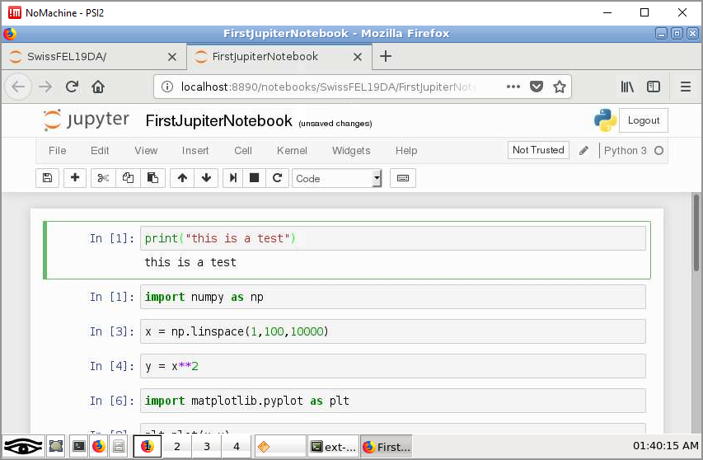
Using Jupyter Notebook
Shift Vs Control Enter

Slide 18
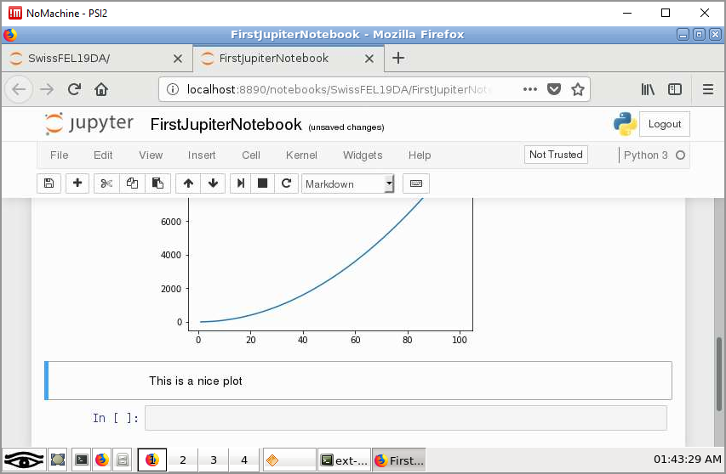
Writing in Jupyter Notebook

Slide 19
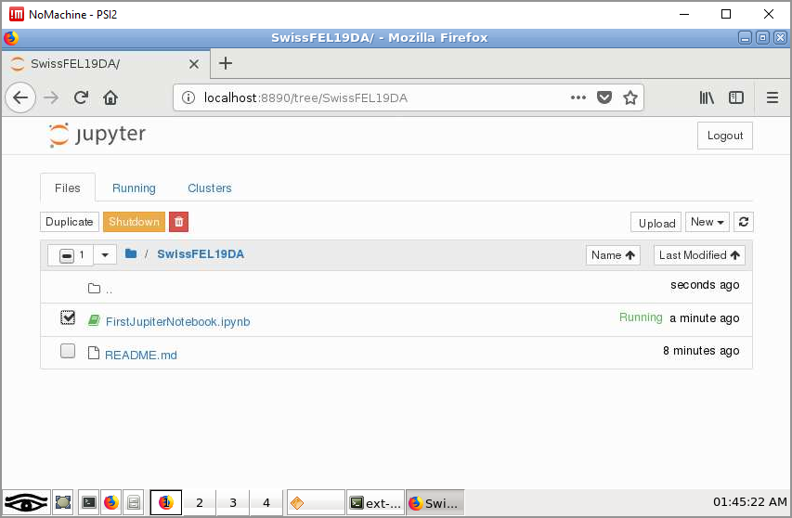
Shutting down a notebook

Slide 20
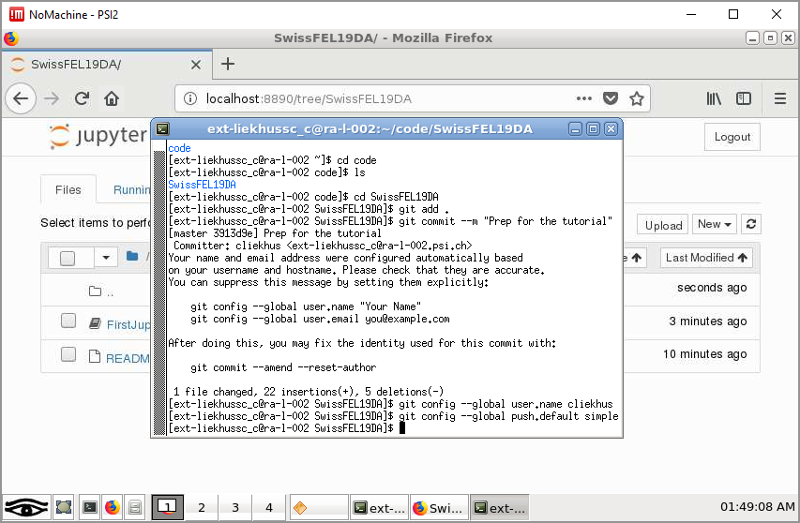
Commit changes

Slide 21
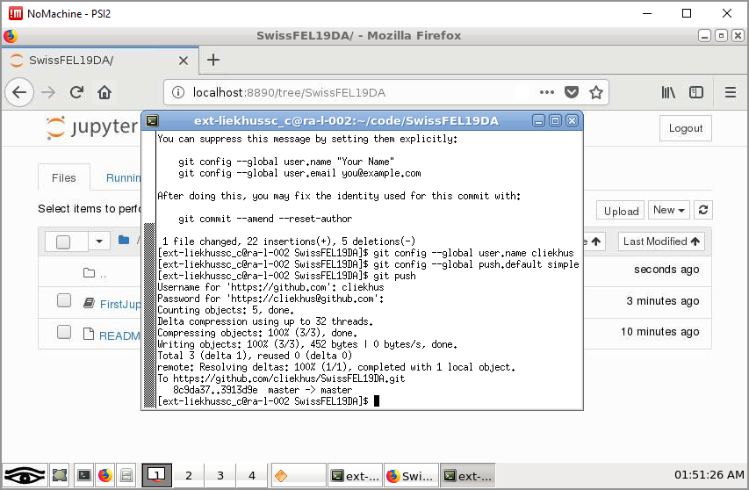
Push changes

Slide 22
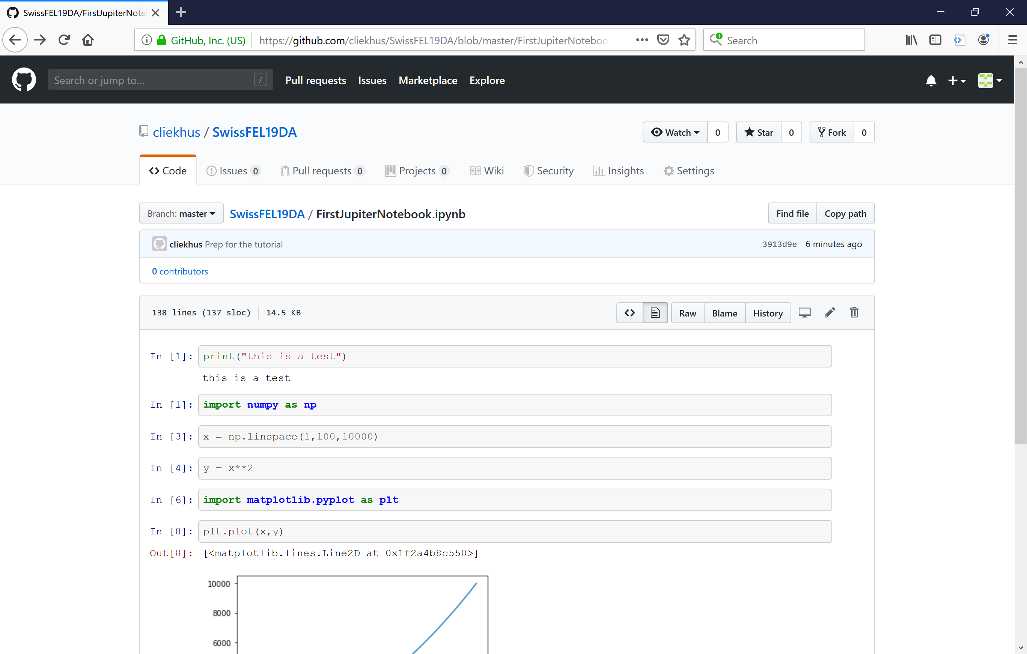

Slide 23
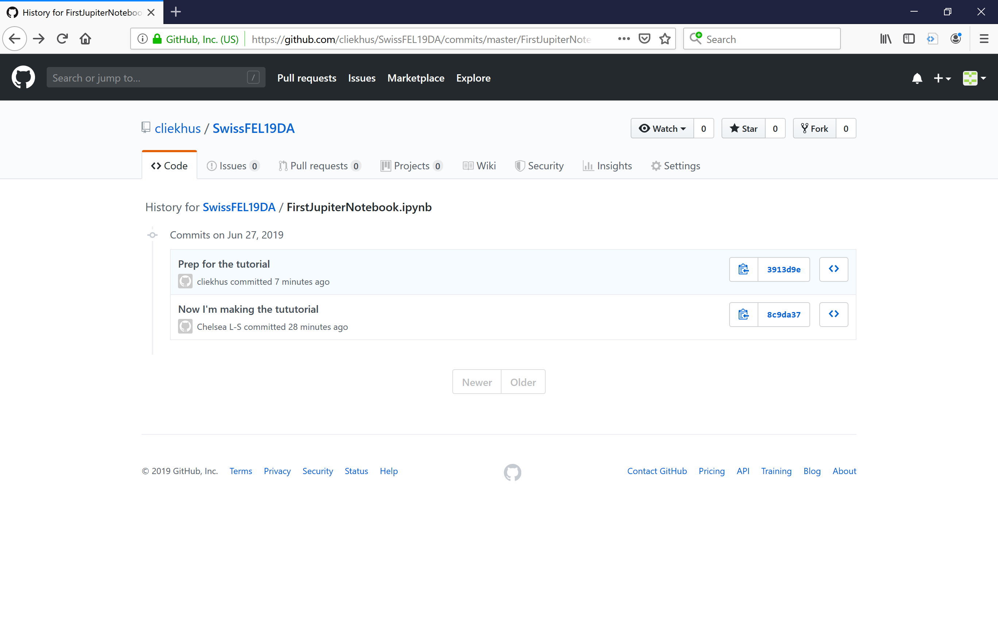

Slide 24
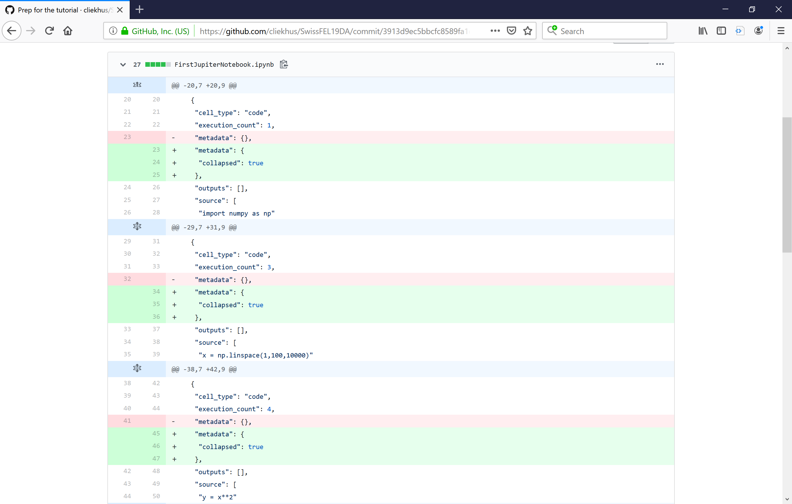

Slide 25
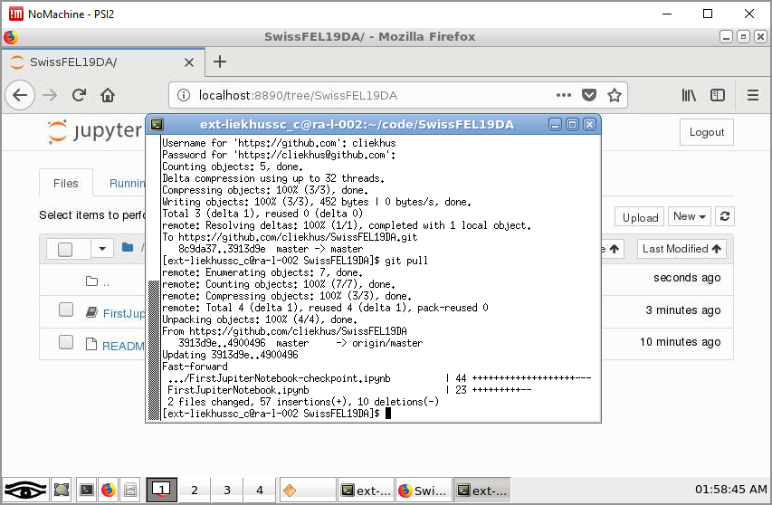
Pull Changes

Slide 26
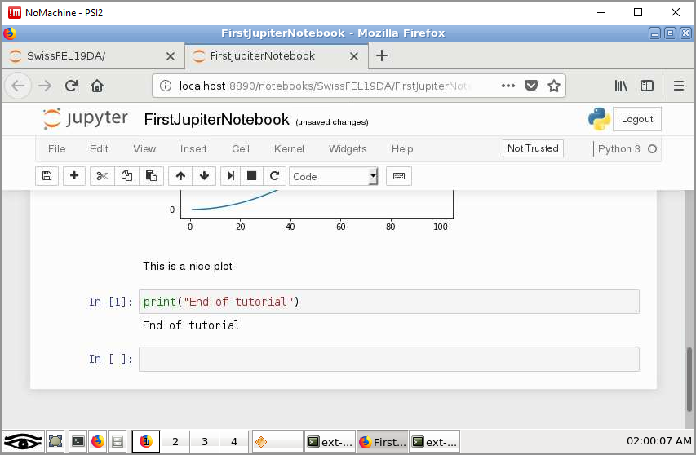
Pull Changes

Slide 27
Other GitHubs
https://github.com/paulscherrerinstitute/alvra_beamline_scripts.git
https://github.com/paulscherrerinstitute/alvra_tools.git

Slide 28
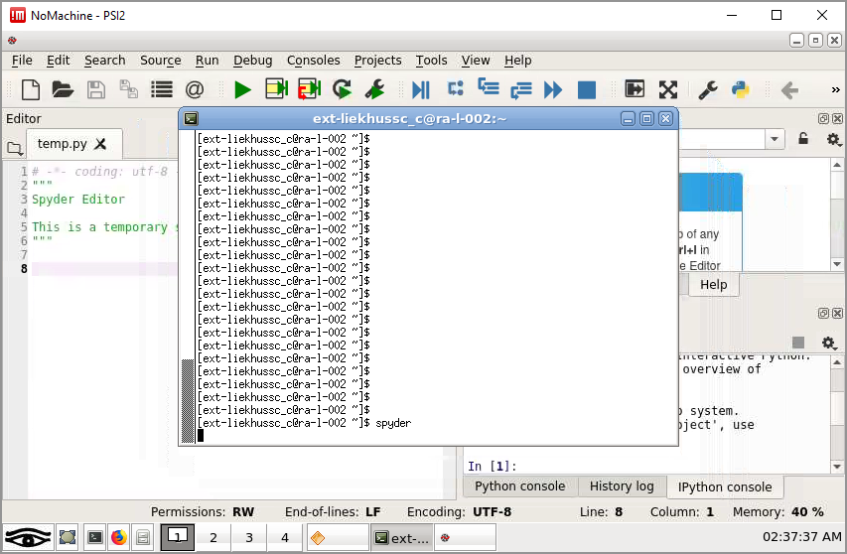
Writing functions – use “spyder”

Slide 29
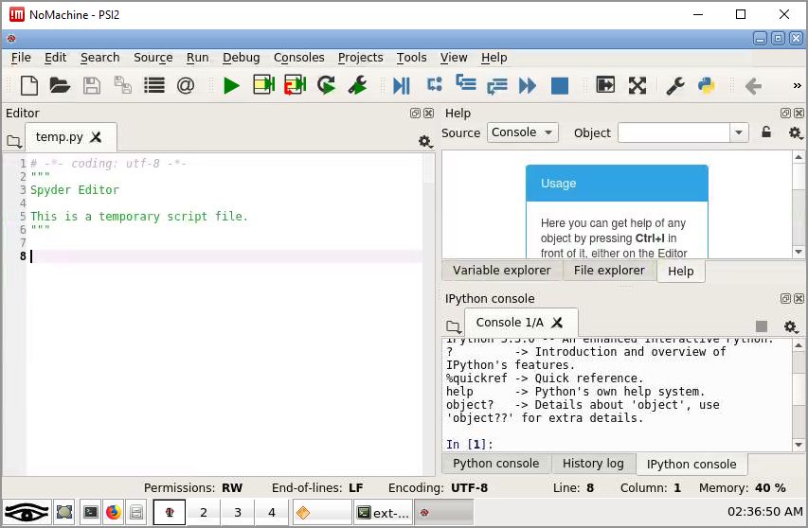
Using Spyder

Slide 30
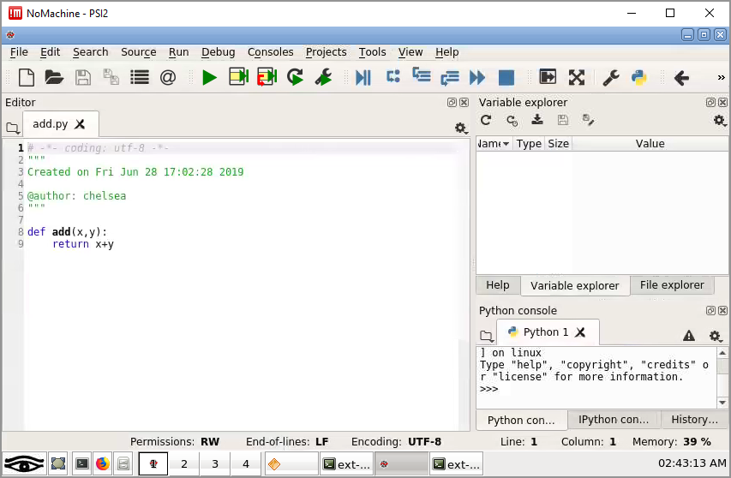
Using Spyder

Slide 31
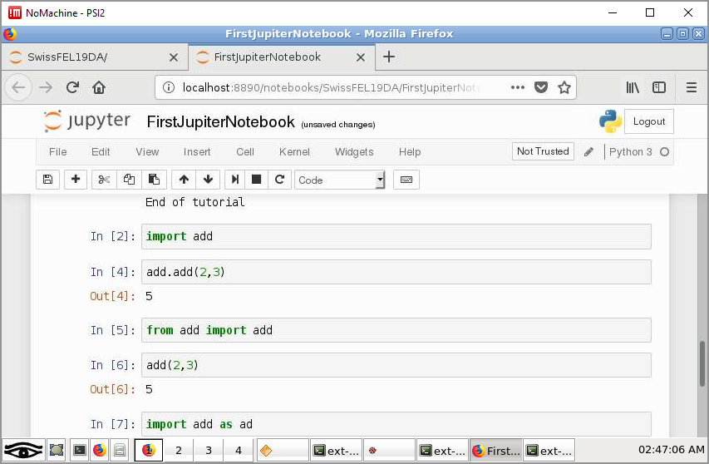
Using modules

Slide 32
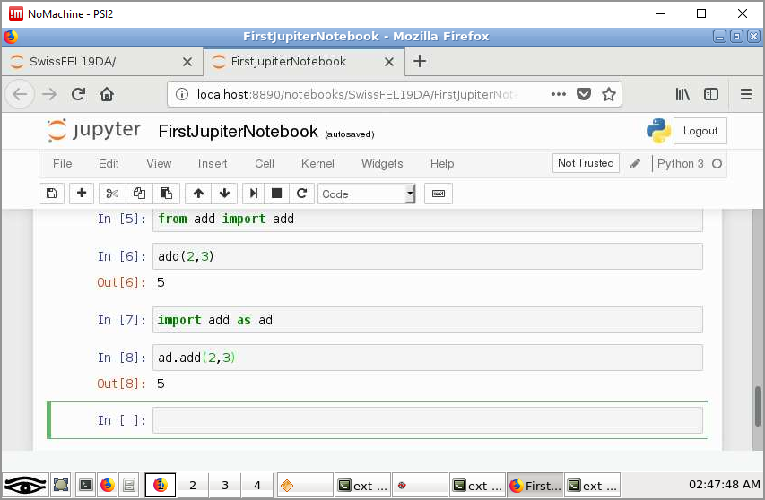
Using modules

